Slide 1
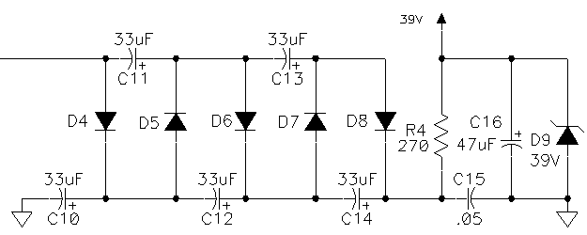
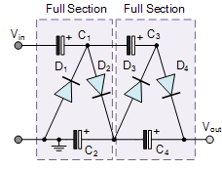
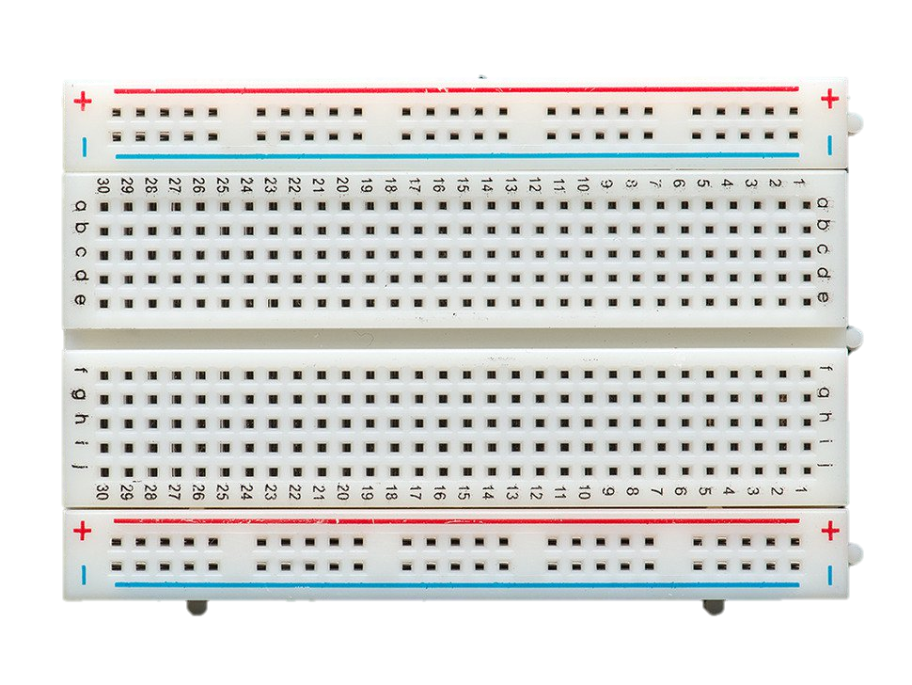
C
C
C
C
D
D
D
D
270
6.8K
C
C

Slide 2
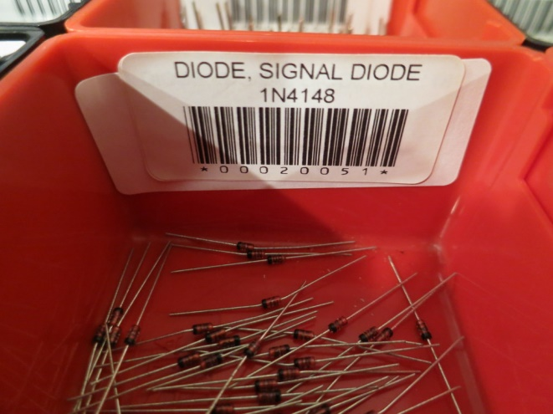
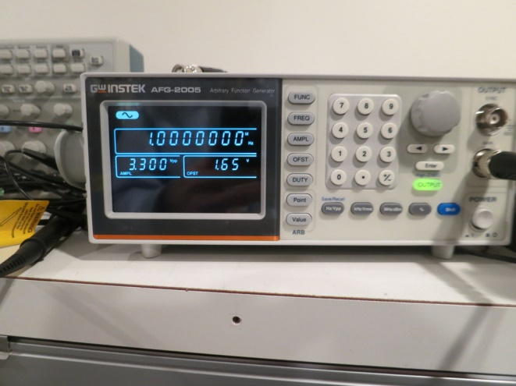
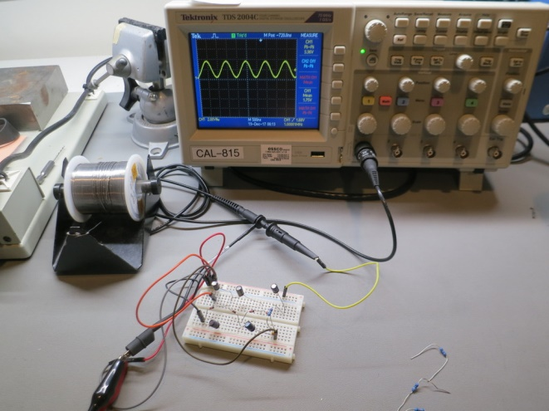
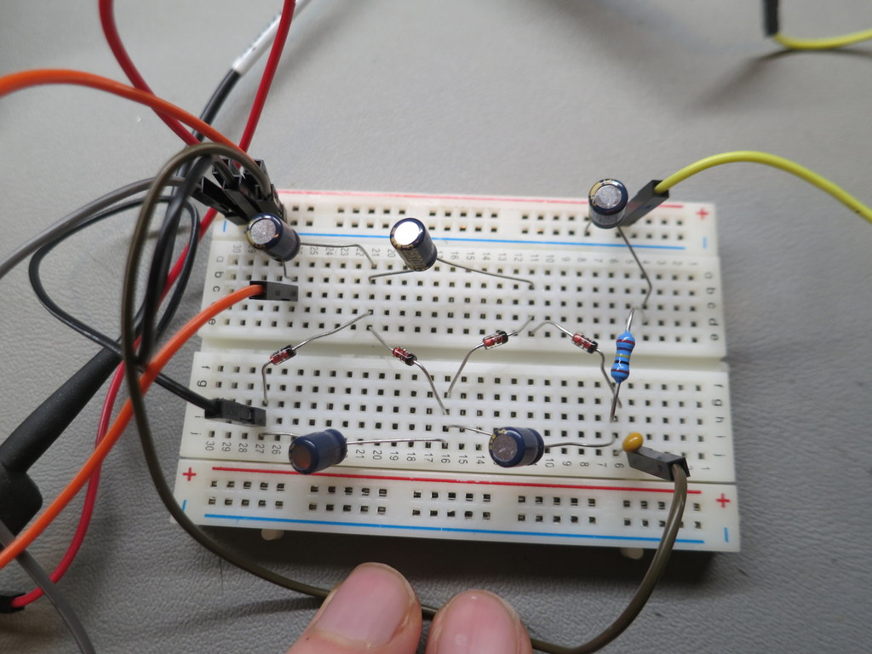
Vin: 3.3Vpp sine, 1.65V offset
Vout: 5.12V DC (inf load)
Vout: 4.69V DC (1M load)
Output Impedance = 92 kOhm
Vin: 3.3Vpp square, 1.65V offset
Vout: 5.54V DC (inf load)
Effective Voltage Multiply:
5.12/(3.3/2/sqrt(2)) =

Slide 3
